Slide 1
MARKET STRUCTURE

Slide 2
MEANING OF MARKET
In common language, market means a place where goods are purchased. However, in economics, market means and arrangement which establish effective relationship between buyers and seller of a commodity. Hence, each commodity has its own market price.
◆ They can participate in sale and purchase.
◆ Market does not referred to a particularplace or location.
◆ It refers to an institutional relationship between purchasers and sellers.
◆ Market is an arrangement which links buyers and sellers.
◆ A market can be of different types.
◆ The market differ from one another due to differences in the number of buyers, number of sellers, nature of the product, influence over price, availability of information, condition of supply etc.

Slide 3
MARKET STRUCTURE
◆ Market structure, in economics, refers to how different industries are classified and differentiated based on their degree and nature of competition for goods and services. It is based on the characteristics that influence the behavior and outcomes of companies working in a specific market.
◆ Market structures show the relations between sellers and other sellers, sellers to buyers, or more.
◆ Some of the factors that determine a market structure include the number of buyers and sellers, ability to negotiate, degree of concentration, degree of differentiation of products, ad the ease or difficulty of entering and exiting the markets.

Slide 4
DETERMINANTS OF MARKET STRUCTURE
The number and nature of sellers.
The number and nature of buyers.
The nature of the product.
The conditions of entry into and exit from the market.
Economies of scale.

Slide 5
PERFECT COMPETITION
DEFINITION:
The term perfect competition refers to a theoretical market structure. In a perfect competition model, there are no monopolies.
Perfect competition is a unique form of the marketplace that allows multiple companies to sell the same product or service. Many consumers are looking to purchase those products. None of these firms can set a price for the product or service they are selling without losing business to other competitors. There are no barriers to any firm that is looking to enter or exit the market. The final output from all sellers is so similar that consumers cannot differentiate the product or service of one company from its competitors.

Slide 6
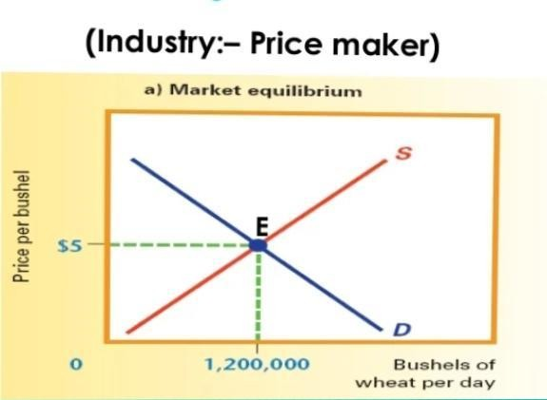
PERFECT COMPETITION FEATURES
Large Number of Buyers and Sellers
Freedom of Entry or Exit of Firms
Homogeneous Product
Absence of Artificial Restrictions
Profit Maximisation Goal
Perfect Mobility of Goods and Factors
Perfect Knowledge of Market Conditions
Absence of Transport Costs
Absence of Selling Costs
No governmental intervention

Slide 7
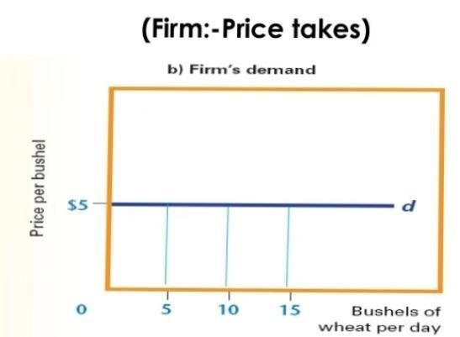
PERFECT COMPETITION

Slide 8
MONOPOLY
Definition
Monopoly is a market situation in which there is only one seller of a product with barriers to entry of others. The product has no close substitutes. The cross elasticity of demand with every other product is very low. This means that no other firms produce a similar product.
Monopoly is the form of market organisation in which there is a single firm selling a commodity for which there are no close substitutes.

Slide 9
MONOPOLY FEATURES
Single Seller and Large Number of Buyers : Single Seller and Large Number of Buyer.A commodity or service is a characteristic of the monopoly market. Individual buyers cannot influence the price of the product.
No Close Substitute: Under the Monopoly market, the commodity or service sold by the seller has no close substitute.
One Firm One Industry: The seller or producer of a commodity or service is firm as well as an industry.There is no distinction between the firm and industry under the monopoly market.
Restriction on Entry Under Monopoly, no form can enter the industry or market as there are several types of artificial and natural restrictions imposed by the monopolist. This restriction may be in the form of copyright, patent, license, owner of mines, etc.
Control over supply: Under Monopoly, the seller of a commodity has full control over the supply and he is a price maker. He is free to fix whatever the charges in order to attain his objective of maximization of profit.
Either Price or Supply Fixation: A Monopoly either fixes the price or determines the supply of its product. He does not do both things simultaneously. In order to maximize his profit, he will either fix the price or control the supply of his output.

Slide 10
OLIGOPOLY
An oligopoly is a market structure with a small number of firms, none of which can keep the others from having significant influence. The concentration ratio measures the market share of the largest firms.

Slide 11
OLIGOPOLY FEATURES
Few sellers
Control over supply
Inter-dependence of firms
Conflicting attitudes of firms
Lack of uniformity of size of firm
Group behaviour
Advertising and selling costs
Price rigidity
Intense competition
Nature of product
Barrier to entry
Inter determinantsness of demand curve

Slide 12
IMPERFECT COMPETITION
◆ Imperfect competition exists whenever a market, hypothetical or real,
competition. In this
violates the abstract tenets of neoclassical perfect
environment, companies sell different products and services, set their own individual prices, fight for market share, and are often protected by barriers to entry and exit.
◆ Imperfect competition is common and can be found in the following types of market structures: monopolies, oligopolies, monopolistic competition, monopsonies, and oligopsonies.

Slide 13
IMPERFECT COMPETITION FEATURES
Types of Imperfect Markets
◆ When at least one condition of a perfect market is not met, it can lead to an imperfect market. Every industry has some form of imperfection. Imperfect competition can be found in the following structures:
Monopoly
This is a structure in which there is only one (dominant) seller. Products offered by this entity have no substitutes. These markets have high barriers to entry and a single seller who sets the prices on goods and services. Prices can change without notice to consumers.
Oligopoly
This structure has many buyers but few sellers. These few players in the market may bar others from entering. They may set prices together or, in the case of a cartel, only one takes the lead to determine the price for goods and services while the others follow.
Monopolistic Competition
In monopolistic competition, there are many sellers who offer similar products that can’t be substituted. Businesses
compete with one another and are price makers, but their individual decisions do not affect the other.
Monopsony and Oligopsony
These structures have many sellers, but few buyers. In both cases, the buyer is the one who manipulates market prices by playing firms against one another.

Slide 15
MONOPOLISTIC COMPETITION
Meaning
Monopolistic competition refers to an imperfectly competitive market with the traits of both the monopoly and competitive market. Sellers compete among themselves and can differentiate their goods in terms of quality and branding to look different. In this type of competition, sellers consider the price charged by their competitors and ignore the impact of their own prices on their competition.

Slide 16
MONOPOLISTIC COMPETITION FEATURES
1.Large number of sellers and buyers. 2.Product differentiation.
A) real differentiation
b) artificial differentiation 3.Non price competition 4.Selling cost
Free entry and free exit
Independent price policy

